Slide 1
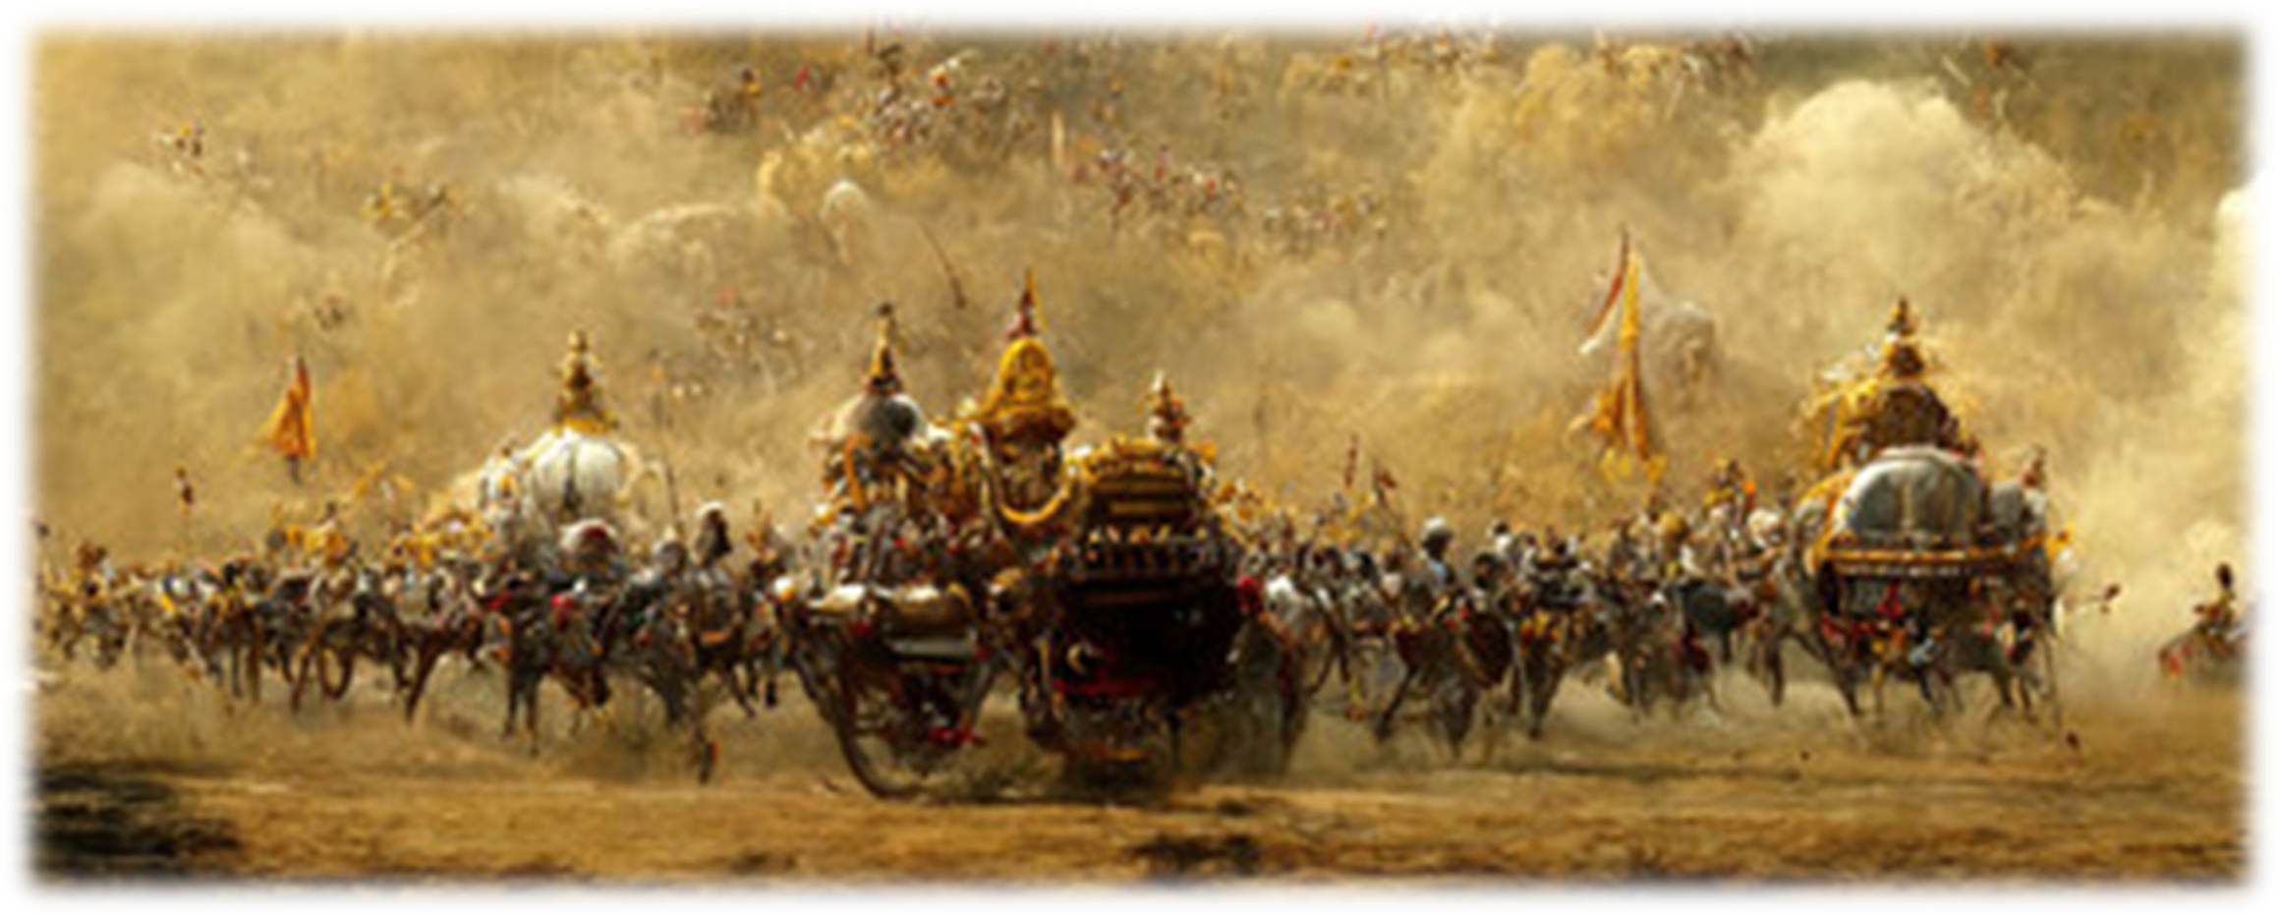
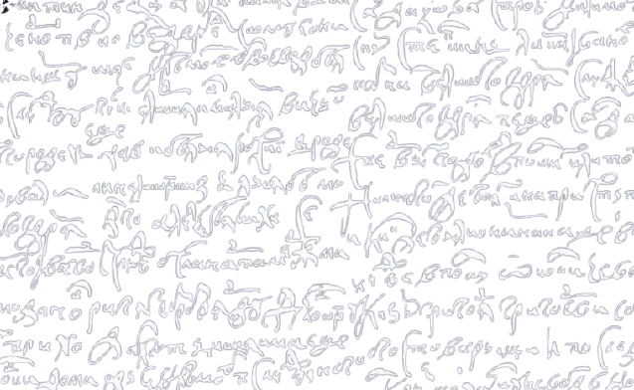
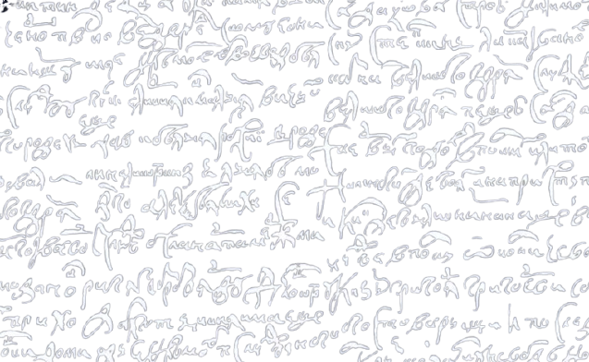
Delhi Public School, Ranipur
Welcomes You
to
The Inter School Literary Competition
English Literati Concurso 2025
Conducting for the last 14 years !

Slide 2
Delhi Public School, Ranipur
Welcomes You
to
The Inter School Literary Competition
English Literati Concurso 2025
Conducting for the last 14 years !

Slide 3
Some ?? of previous
English Literati Concurso 2025

Slide 4
Competition Details
• Team Composition: Maximum 5 participants
• Eligibility: Students of Grades IX to XII
• Language: English
• Time Limit: 5 minutes (inclusive of monologue and self-reflection)
• Theme: Indian Mythology
• Prizes:
o 1st Prize: ₹5,000
o 2nd Prize: ₹4,000
o 3rd Prize: ₹3,000
o Participation Certificates for all the participants

Slide 5
Judging Criteria (Total: 50 Marks)
Content 10
Expression 10
Diction & Dialogue Delivery 10
Villain’s Speech 10
Costume & Props (Max. 3) 10

Slide 6
Presentation Format
• Part 1: A dramatic enactment of a selected scene from Indian mythology, focusing on portraying
the chosen character as a victim.
• Part 2: A 1-minute monologue by the "villain," presenting their personal perspective and
explaining the circumstances behind their actions or downfall.

Slide 7
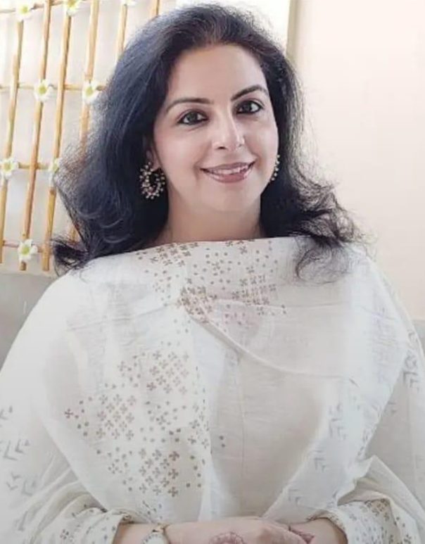
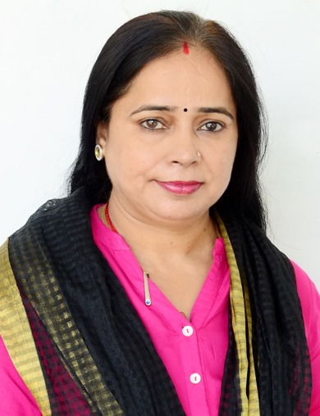
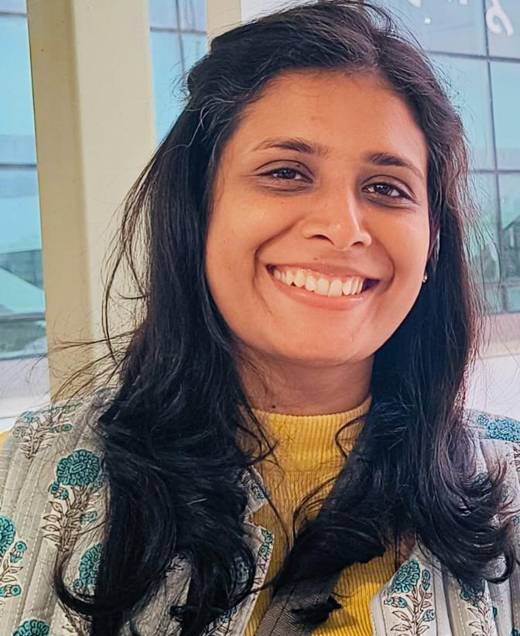
English Literati Concurso 2025
Ms. Shikha Kumar
Personality Development Trainer
Dr Bharti Sharma
Associate Professor in the Department of English at S.D. College, Roorkee
Dr. Aashima Sharma
Head of the Modern Subjects Department at Shri Bhagwan Das Sanskrit Mahavidyalaya
Today’s
Panel of Judges

Slide 8
English Literati Concurso 2025
Ms. Shikha Kumar
Personality Development Trainer
Dr. Aashima Sharma
Head of the Modern Subjects Department at Shri Bhagwan Das Sanskrit Mahavidyalaya
Dr Bharti Sharma
Associate Professor in the Department of English at S.D. College, Roorkee

Slide 9
English Literati Concurso 2025
Dr Bharti Sharma
Associate Professor in the Department of English at S.D. College, Roorkee
Ms. Shikha Kumar
Personality Development Trainer
Dr. Aashima Sharma
Head of the Modern Subjects Department at Shri Bhagwan Das Sanskrit Mahavidyalaya

Slide 10
English Literati Concurso 2025
Ms. Shikha Kumar
Personality Development Trainer
Dr Bharti Sharma
Associate Professor in the Department of English at S.D. College, Roorkee
Dr. Aashima Sharma
Head of the Modern Subjects Department at Shri Bhagwan Das Sanskrit Mahavidyalaya

Slide 11
Welcome
Dr. Aashima Sharma
Dr Bharti Sharma
Ms. Shikha Kumar

Slide 12
English Literati
Concurso 2025

Slide 13
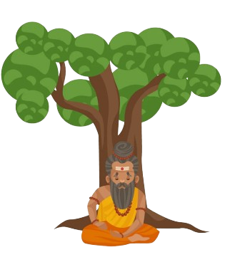
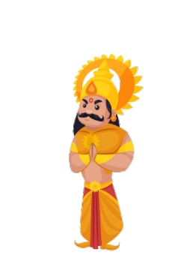
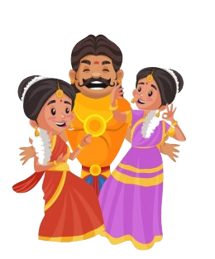
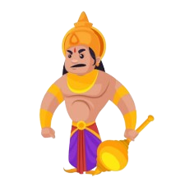
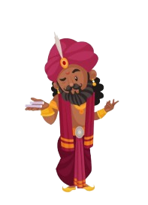
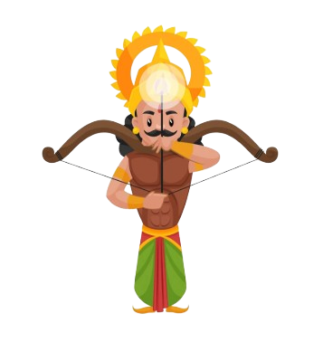
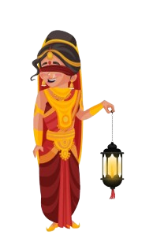
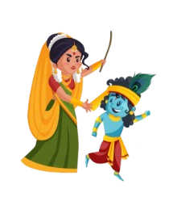
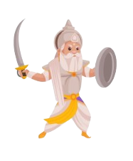
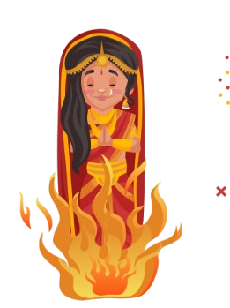
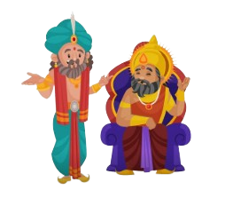
Thank you to all the participants,
making mythology breathe, speak, and shine on this stage,
with the creative and unforgettable performances !

Slide 14
Waiting for results ...
English Literati
Concurso 2025

Slide 15
English Literati
Concurso 2025
Results Declared !
Waiting for results ...

